Slide 1
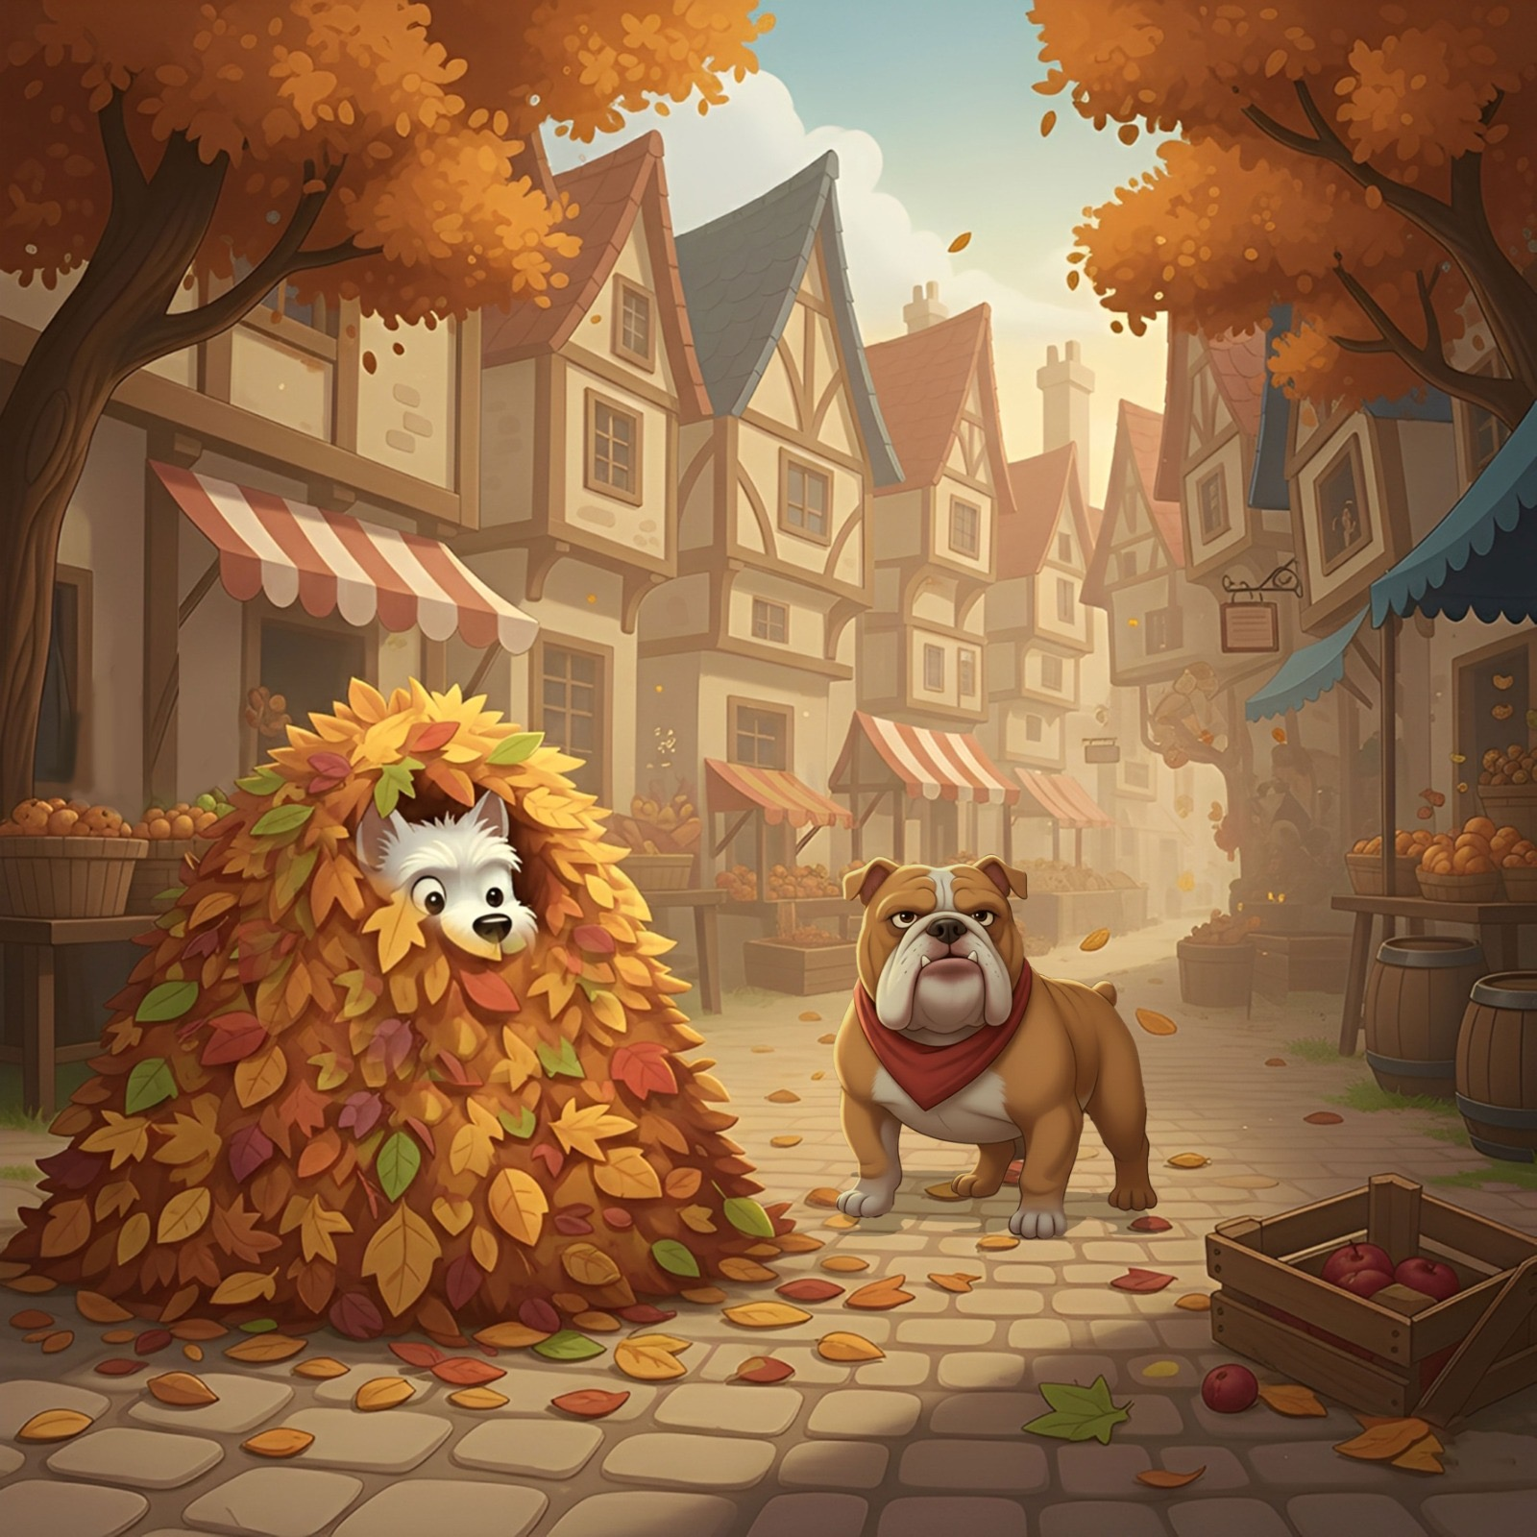
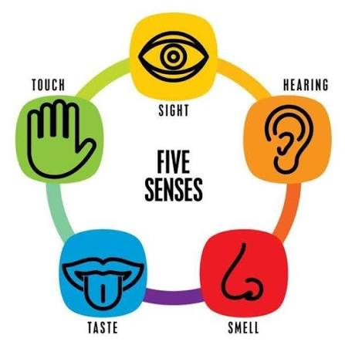
speed | autumnal | pile | scattered
nowhere | orange | red | bandana
fruit box | cobblestones | huffing | scraping
Bruno stopped.
Add adjective(s) to describe the character.
Now, add an adverb of manner.
Now, add a fronted adverbial.

Slide 2
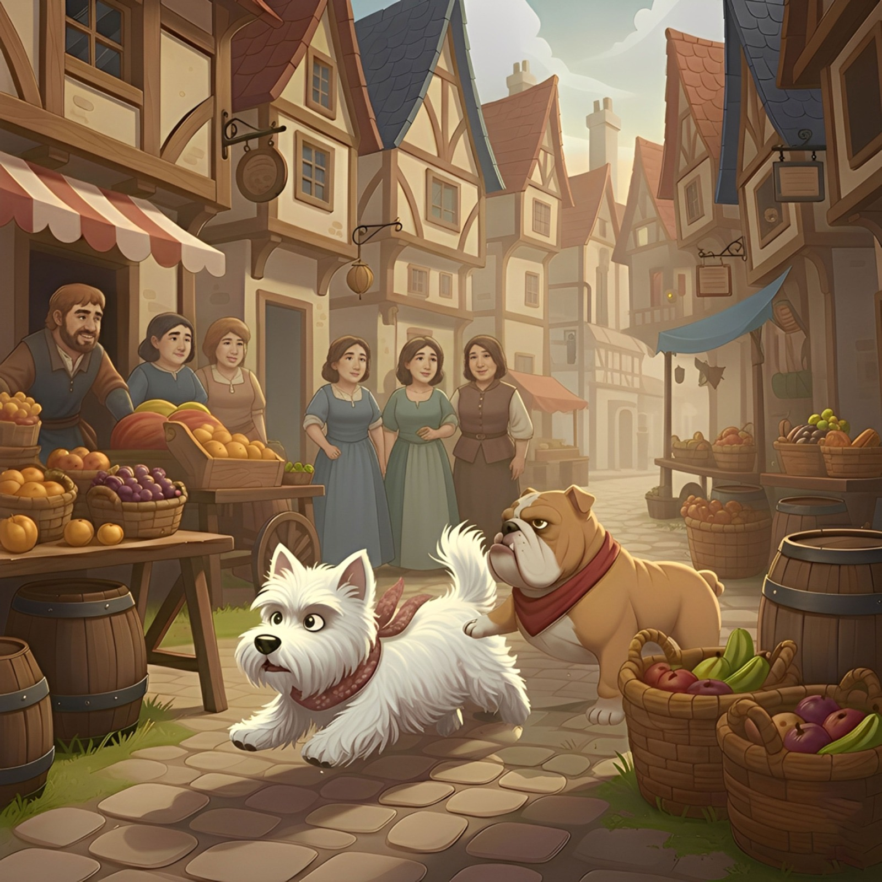
dashed | people | market | chatter
barrels | grey | crowded | pitter patter
fruit boxes | cobblestones | panting | gasps
Skye sprang into action.
Add adjective(s) to describe the character.
Now, add an adverb of manner.
Now, add a fronted adverbial.

