Slide 1
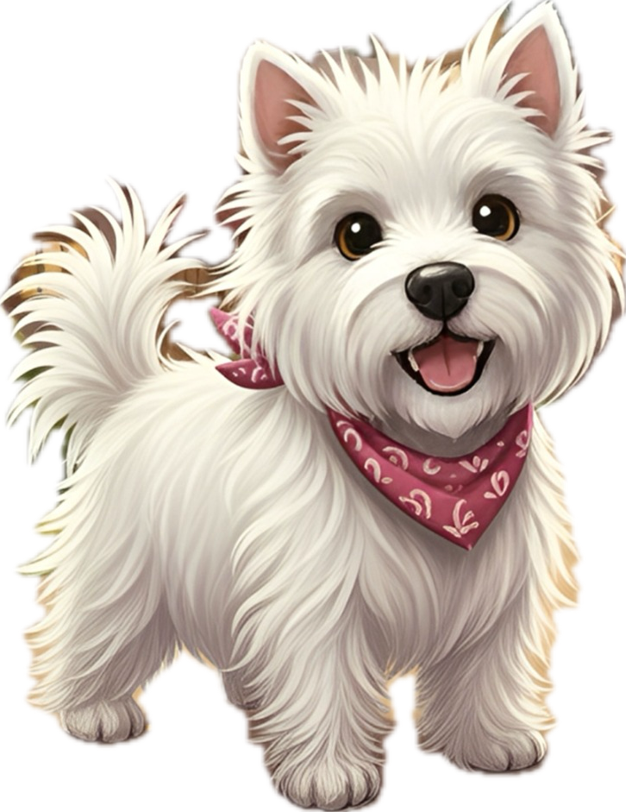
 | Tally | Total
1 point words
3 point words
5 point words
 | Overall Total
Skye
dog
biscuits
leaves
ordinary
delicious
curiosity
chuckled
scratched
playful
paws
smell
excitedly
mischievous
tiptoeing
adventures
bakery
mischief
bark
street

